Slide 1
CS601-Data Communication
VU
LECTURE #11
Signals
Need For Signals
One of the major concerns of Physical layer is moving information in the form of electromagnetic signals across a TX medium
Information can be voice, image, numeric data, characters or any message that is readable and has meaning to the destination user (human or m/c)
Generally, the info usable to a person or application is not in a form that can be transmitted over a network
For Example, you cannot roll up a photograph, insert it into the wire and transmit it across the city
You can transmit however an encoded description of the photograph
The binary digits must be converted into a form that TX. Medium can accept
TX. Media work by conducting energy along a physical path. So the data stream of 1s and 0s must be turned into energy in the form of EM signals
Analog and Digital
Both data and signals that represent them can take either analog or digital form
ANALOG
Analog refers to something that is continuous in time
Continuous– A set of specific points of data and all possible points b/w them
DIGITAL
Digital refers to something that is discrete
Discrete– A set of specific points of data with no points in between
Data can be Analog or Digital
Example of ANALOG Data is Human voice
When somebody speaks, a continuous wave is created in the air.
This can be captured by a Microphone and converted to an Analog Signal
An example of DIGITAL data is Data stored in the memory of a computer in the form of 1s and 0s. It is usually converted to a digital signal when it is transferred from one position to the other inside or outside the computer
Signals can be Analog or Digital
ANALOG Signal

Slide 2
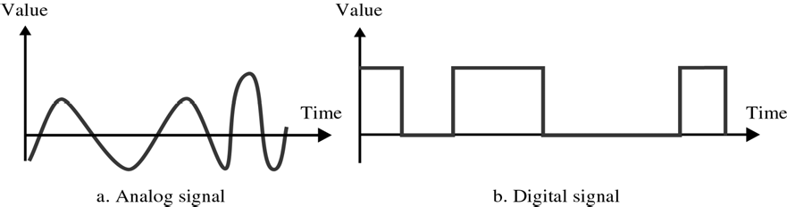
CS601-Data Communication
VU
It is a continuous waveform that changes smoothly over time
As the wave moves from value ‘ A’ to value ‘B’, it passes through and includes an infinite number of values along its path
DIGITAL Signal
A digital signal is discrete. It can have only a limited number of defined values, often as simple as 1s and 0s
The transition of a digital signal from value to value is instantaneous like a light being switched ON and OFF
Analog and Digital Signals
We illustrate signals usually by plotting them on a pair of perpendicular axis
Vertical axis represent the value or the strength of the signal
Horizontal axes represent the passage of time
The curve representing the Analog signal is smooth and continuous, passing through an infinite number
The vertical lines of the digital signal shows the sudden jump the signal makes from value to value. The flat highs and the lows represent that those values are fixed
In short, Analog signal varies continuously w.r.t Time whereas Digital signal varies instantaneous
Periodic and Aperiodic Signals
Signals (Analog or Digital)
Periodic
Aperiodic

Slide 3
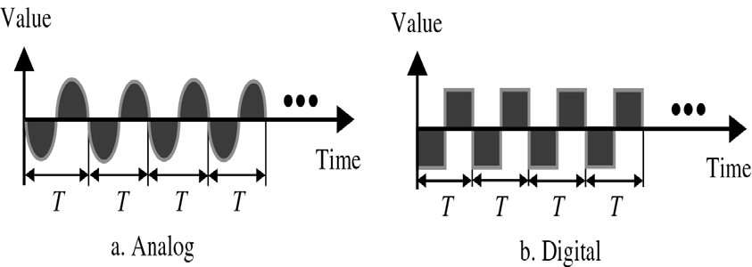
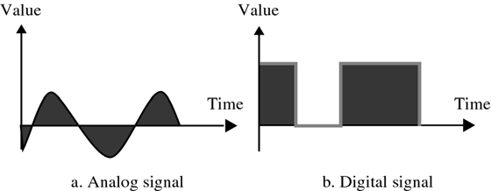
CS601-Data Communication
VU
Periodic Signals
A signal is called Periodic if it completes a pattern within a measurable time frame called a Period and then repeats that pattern over identical subsequent Periods
The completion of one full pattern is called a CYCLE
Period: Time required (in Seconds) to complete one full cycle, represented by ‘T’
Aperiodic Signals
o An Aperiodic or Non-Periodic signal is the one that changes constantly without exhibiting a pattern or cycle that repeats over time
Fourier Transform
It has been proved by a technique called FOURIER TRANSFORM that any Aperiodic signal can be decomposed into an infinite number of Periodic Signals
ANALOG SIGNALS
Analog signals can be classified as Simple or Composite
Simple Analog Signal(Sine Wave)
–Cannot be decomposed into simpler signal
Composite Analog Signal
–Composed of multiple sine waves
Sine Waves
Sine Waves are the most fundamental form of Periodic Analog Signals
The curve oscillates over the course of a cycle smoothly and consistently

Slide 4
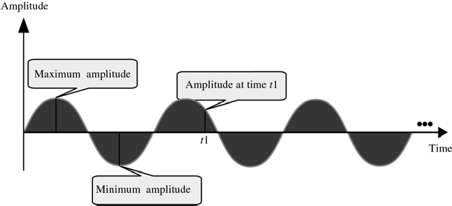
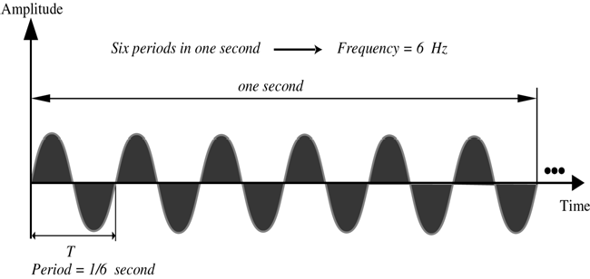
CS601-Data Communication
VU
Each cycle consists of a single arc above the time axis followed by a single arc below it
Sine Waves can be fully described by three characteristics:
Amplitude
Period/Frequency
Phase
Amplitude
Amplitude of a signal is the value of the signal at any point on the wave
It is equal to the vertical distance from a given point on the wave form to the horizontal axis
The maximum amplitude of the sine wave is equal to the highest value it reaches on the vertical axis
Amplitude measured in Volts, Amperes or Watts
Period & Frequency
Period: Amount of time ( in seconds) a signal need to complete one cycle
Frequency: Number of cycles completed in one second
Unit of Period: Period is expressed in seconds
Communication industry uses 5 units to measure period
Frequency is measured in hertz, There are 5 units used in Hertz

Slide 5
CS601-Data Communication
VU
Seconds Hertz Milliseconds Kilohertz Microseconds Megahertz Nanoseconds Gigahertz Picoseconds Terahertz
Summary
Signals
Analog and Digital
Analog and Digital Data & Signals
Periodic & Aperiodic Signals
Sine Waves and its Characteristics
Reading Sections
*Section 4.1, 4.2, 4.3“Data Communications and Networking” 4th Edition by Behrouz A. Forouzan
60

Slide 6
CS601-Data Communication
VU
LECTURE #12
Problems 4.3
A Sine wave has a frequency of 6 Hz. What is its period? Solution
T = ¹ = ¹ = 0.17 sec
f 6
Problems 4.5
A Sine wave completes one cycle in 4 seconds. What is its frequency? Solution:
f = ¹ = ¹ = 0.25Hz T 4
Another Way to look at Frequency
Measurement of the rate of change
The rate at which a sine wave moves from its lowest to its highest point is its frequency
A 40 Hz signal has half the frequency of a 80 Hz signal, therefore each cycle takes twice as long to complete one cycle I.e. to go from its lowest to its highest
Change in a short Time = High Frequency
Two Extremes Frequency
What if a signal does not change at all?
What if it maintains a constant voltage level the entire time?
In such cases , Frequency is going to be zero
If a signal does not change, it will never complete any cycles, and frequency is no. of cycles in 1 second so Freq = 0
No change at all ⇒
– Zero frequency
o Instantaneous changes ⇒
– Infinite frequency
Phase
Phase describes the position of the waveform relative to time zero
If we think of the wave as something that can be shifted backward or forward along the time axis
Phase describes the amount of that shift
It indicates the status of the first cycle
Phase is measured in Degrees or Radians
360 degrees – 2 pi Radians
A phase shift of 360 degrees correspond to a shift of a complete period
A phase shift of 180 degree correspond to a shift of half a period
A phase shift of 90 degree correspond to a shift of quarter a period

Slide 7
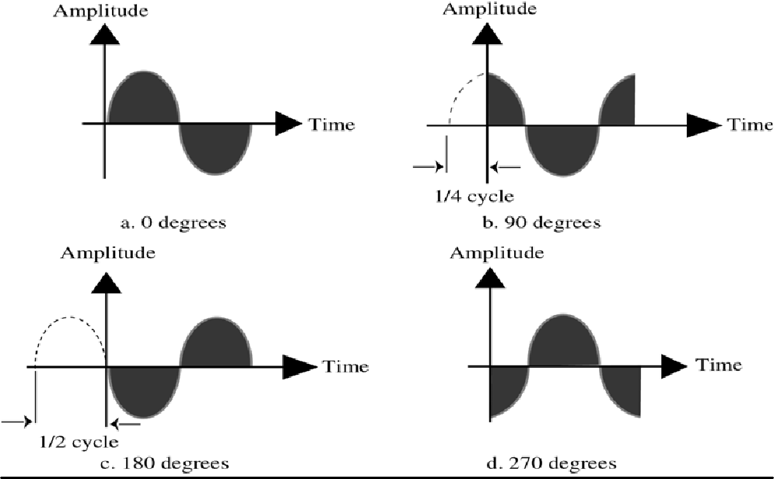
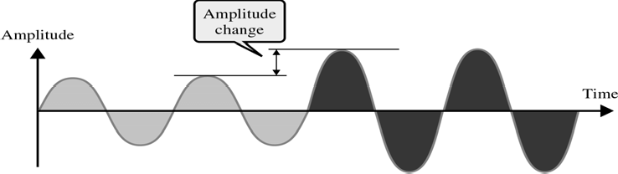
CS601-Data Communication
VU
Problem 4.7
A sine wave is offset Solution
1
of a cycle with respect to time zero. What is its phase?
6
One Cycle = 360 Degrees
1
6
of a cycle =³⁶⁰ = 60 Degrees
6
Control of Signals
Signal can be controlled by three attributes:
Amplitude
Frequency
Phase
Control of Signals- Amplitude
Control of Signals- Frequency

Slide 8
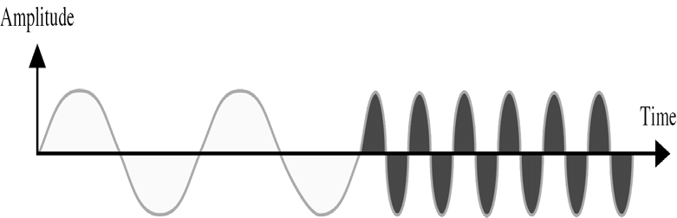
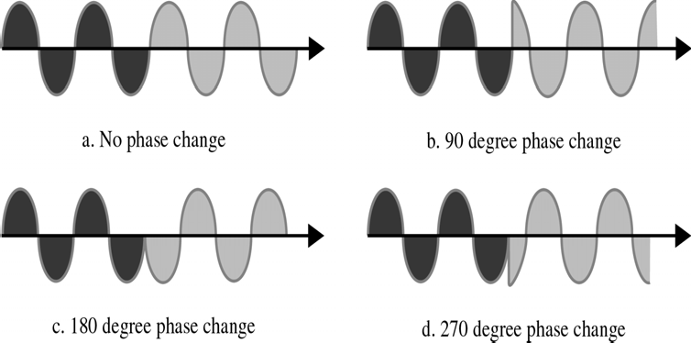
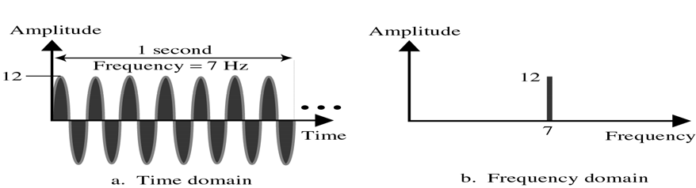
CS601-Data Communication
VU
Control of Signals- Phase
Time and Frequency Domain
Time Domain plots show changes in signal amplitude w.r.t Time
It is an Amplitude versus Time Plot
Phase and Frequency are not explicitly measured on a Time domain plot
To show the relationship between amplitude and Frequency, we can use what is called a Frequency Domain Plot
Time and Frequency Domain Example

Slide 9
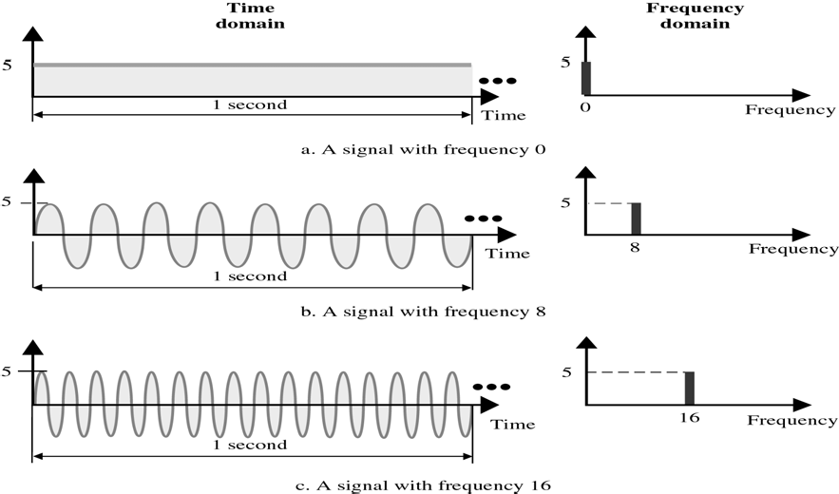
CS601-Data Communication
VU
Figure compares the time domain (instantaneous amplitude w.r.t Time) and the Frequency domain (Max amplitude w.r.t Frequency)
Low Frequency signal in frequency domain corresponds to a signal with longer period in Time domain & vice versa.
A signal changing rapidly in Time domain corresponds to High frequency in Frequency domain
Figure shows 3 signals with different frequencies and its time and frequency domain presentations
Composite Signals
Second type of Analog Signals, that is composed of multiple sine waves
So far we have been focused on simple periodic signals or sine waves
Many useful sine waves do not change in a single smooth curve b/w minimum and maximum amplitude.
They jump, slide , wobble and spikeAs long as as any irregularities are consistent, cycle after cycle, a signal is still Periodic
It can be shown that any periodic signal no matter how complex can be decomposed into a collection of sine waves, each having a measurable amplitude, frequency & phase
We need FOURIER ANALYSIS to decompose a composite signal into its components

Slide 10
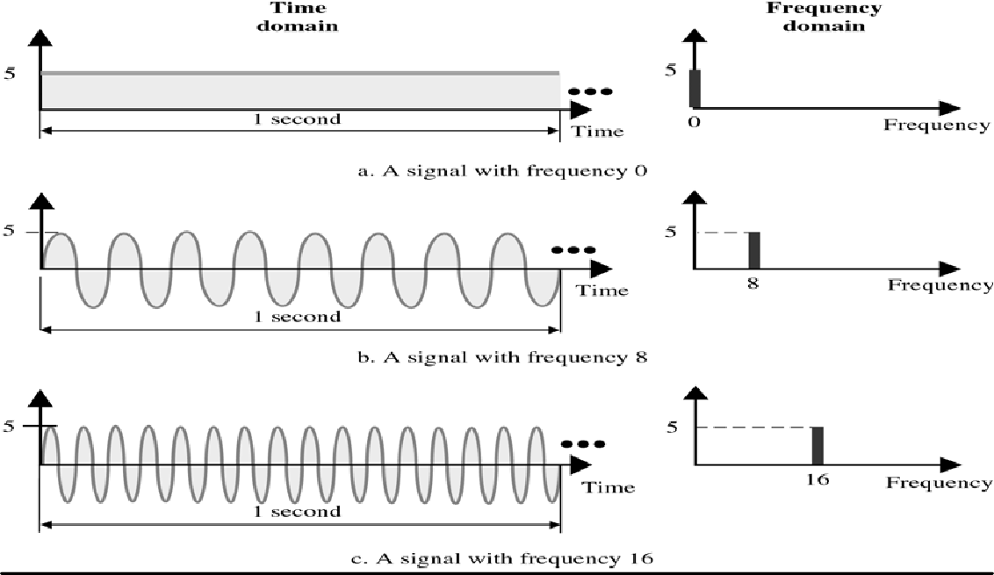
CS601-Data Communication
VU
Figure shows a periodic signal decomposed into two sine waves
First sine wave (middle one) has a frequency of ‘6’ while the second sine wave has a frequency of ‘0’
Adding these two signals point by point results in the top graph
Original signal looks like a sine wave that has its time axis shifted downward
This shift is because of DC Component or zero frequency component in the signal
If you look at the signal in time domain, a single point is there while in frequency domain , two component freq.'s are there
Summary
Sine Waves and its Characteristics
Control of Signals
Time and Frequency Domain
Composite Signals
Reading Sections
Section 4.4, 4.5 “Data Communications and Networking” 4th Edition by Behrouz
Forouzan

Slide 11
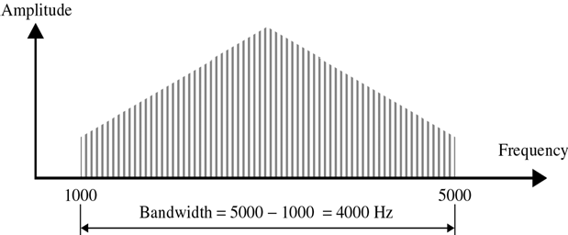
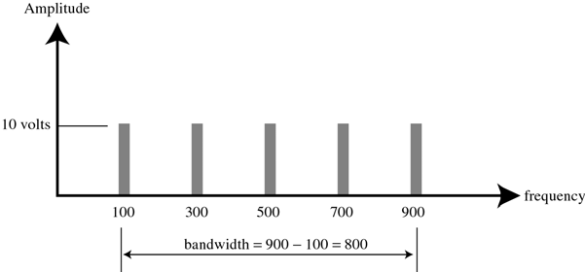
CS601-Data Communication
VU
LECTURE #13
Frequency Spectrum / Bandwidth
Frequency Spectrum: of a signal is the collection of all the component frequencies it contains
It is shown using a Frequency domain graph
Bandwidth: of a signal is the width of the frequency spectrum
In other words ,Bandwidth refers to the range of the component frequencies and Frequency Spectrum refers to the elements within that range
How to calculate Bandwidth?
To calculate Bandwidth, subtract the lowest frequency from the highest frequency
*
SLIDE
Example 4.8
If a periodic signal is decomposed into five sine waves with frequencies 100, 300, 500, 700, and 900 Hz, what is the Bandwidth?
Solution
B = f_{h} − f_{l} = 900 −100 = 800Hz
Other Definitions of Bandwidth
3 dB Bandwidth or Half Power Bandwidth
H ( f )

Slide 12
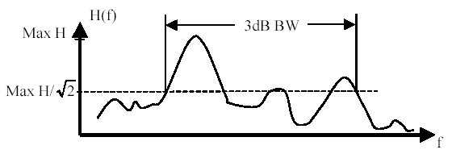
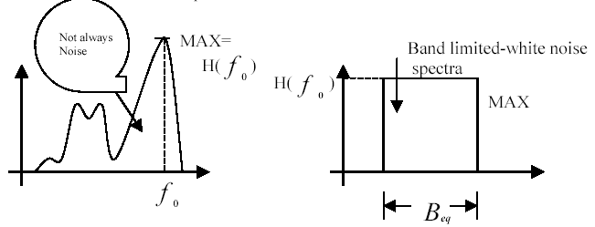
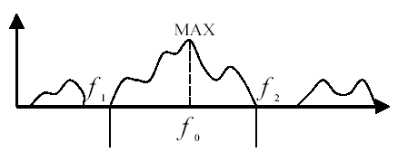
CS601-Data Communication
VU
For the magnitude spectra of
, the range of the spectrum that does not
fall lower than 1 times the max. _{H ( f )}
2
Equivalent Noise Bandwidth
The width of a fictitious rectangular spectrum created to have the same power in the rectangular band as the power of the signal in positive frequencies
Null-to-Null Bandwidth or Zero Crossing Bandwidth
If the maximum frequency in a spectrum is
^{f} o ,the
first null above and
below f _{o} will be Null Bandwidth
f₁ f₂
and
, where
f₁ − f₂
is the Null-to-
Power Bandwidth
Frequency Band in which 99% of the total power resides

Slide 13
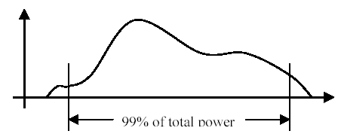
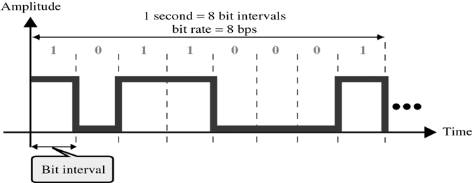
CS601-Data Communication
VU
Digital Signals
In addition to being represented by Analog Signals, data can also be represented by a Digital signal
Bit Interval and Bit Rate
Most digital signals are aperiodic and thus Period and Frequency are not the appropriate terms to describe them
Bit Interval (seconds)
Time required to send one single bit
Bit Rate (bps)
Number of bits sent per second
Frequency Spectrum of a Digital Signal
Frequency spectrum of a digital signal contains an infinite number of frequencies with different amplitudes
Ideally we want to send all the components but if we send only those components
whose amplitudes are significant , we can still recreate the digital signal with reasonable accuracy at the receiver

Slide 14
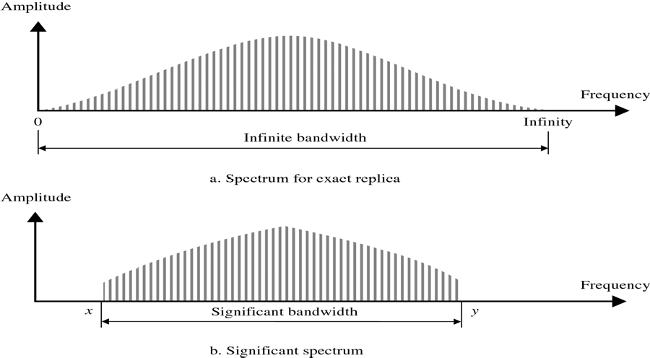
CS601-Data Communication
VU
Summary
Frequency Spectrum and Bandwidth
Other Definitions of Bandwidth
Digital Signals
Reading Sections
* Section 4.4, 4.5, 4.6 Behrouz A. Forouzan
“Data Communications and Networking” 4th Edition by

Slide 15
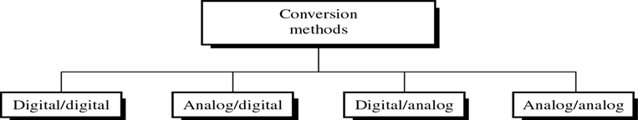
CS601-Data Communication
VU
LECTURE #14
Conversions
Introduction
Information must be transformed into signals before it can be transported across the communication media
How info is transformed depends on its original format and on the format used by the communication device
If you want to send a letter by a smoke signal, you need to know which smoke patterns make which words in your message before building the fire
Words are the Information and the puffs of smoke are representation of that information
Introduction to the type of Conversions
Data stored in the computer is in the form of 0’s and 1’s. To be carried from one place to the other, data is usually converted to digital signals
This is called “Digital-to-Digital Conversion” or “Encoding digital data into
digital signals”
Sometimes we need to convert an analog signal to the digital signal
For Example, conversion of Telephone conversation to digital signal for a no. of different reasons such as to decrease the effect of noise
This is called “Analog-to-Digital Conversion” or “Digitizing an Analog
Signal”
We might want to send a digital signal coming out of computer through a medium designed for analog signals
For example, To send data from one place to the other using a Telephone line
This is called “Digital-to-Analog Conversion” or “Modulating a digital Signal”
Often an analog signal is sent over long distances using analog media
For Example, voice or music from a radio station which is an analog signal is transmitted through the air, however the frequency of voice or music is not suitable for this kind of Tx.
The signal should be carried by a higher frequency signal
This is called “Analog-to-Analog Conversion” or “Modulating an analog Signal”
Types of Conversions
Digital-to-Digital Conversion
o Digital-to-Digital conversion/encoding is the representation of digital information by digital signal
70

Slide 16
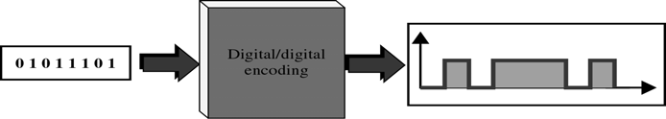
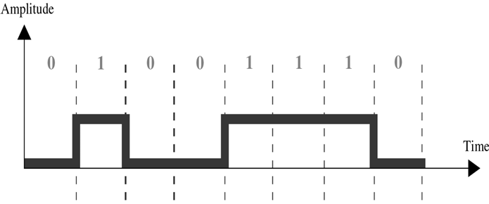
CS601-Data Communication
VU
For Example when you Tx data from Computer to the Printer, both original and transmitted data have to be digital
In this type of encoding, 1’s and 0’s generated by the computer are translated into voltage pulses that can be propagated over the wire
o Figure shows the relationship between digital information, digital-to-digital encoding hardware , and the resultant digital signal
Types of Digital-to-Digital Encoding
Digital/Digital Encoding
Unipolar
Polar
Bipolar
UNIPOLAR
Encoding is simple , with only one technique in use
Simple and Primitive
Almost Obsolete Today
Study provides introduction to concepts and problems involved with more complex encoding systems
Digital Transmission system works by sending voltage pulses on the Tx. Medium
One voltage level stands for binary 0 while the other stands for binary 1
It is called Unipolar because it uses only one polarity

Slide 17
CS601-Data Communication
VU
This polarity is assigned to to one of the two binary states usually a ‘1’
The other state usually a 0 is represented by zero voltage
Figure shows the idea: 1’s are encoded as +ve values, and 0’s are encoded as –ve values
Pros and Cons of Unipolar Encoding
PROS
Straight Forward and Simple
Inexpensive to Implement
CONS
DC Component
Synchronization
DC Component
Average Amplitude of a unipolar encoded signal is non-zero
This is called DC Component I.e. a component with zero frequency
When a signal contains a DC Component, it cannot travel through a Tx. Medium that cannot handle DC components
Synchronization
When the signal is unvarying, Rx. Cannot determine the beginning and ending of each bit
Synchronization Problem can occur when data consists of long streams of 1’s or 0’s
Therefore, Rx has to rely on a TIMER
Consider we have a bit rate of the signal to be 1000bps
1000 bits in 1 second
1 bit in 0.001 second
So if a +ve voltage lasts 0.005 sec, it reads five 1’s
Sometimes it stretches to 0.006 seconds and an extra one bit is read by the Rx
Solution:
– Separate Parallel Line
Carries a clock pulse and allows receiver to resynchronize its timer to that of the signal
Doubling no. of Tx lines increase Cost and proves uneconomical
POLAR
Encoding has 3 subcategories:
Non Return to Zero (NRZ),-- Return to Zero (RZ)
Bi phase
Two of which have multiple variations of their own
Polar encoding uses two voltage levels
–One positive and one negative

Slide 18
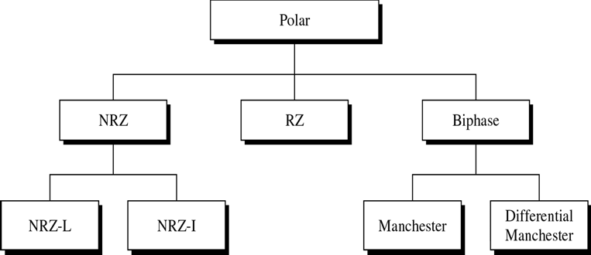
CS601-Data Communication
VU
By using two voltage levels, average voltage level on the line is reduced and DC Component problem of unipolar encoding is alleviated
Types of Polar Encoding
Non Return to Zero (NRZ)
o In NRZ Encoding, the level of signal is either positive or negative
 |  | NRZ
NRZ-L |  |  |  |  | NRZ-I
NRZ-L
Level of the signal depends on the type of bit it represents
A +ve voltage usually means the bit is a 1 and a –ve voltage means the bit is a 0 (vice versa)
*Problem with NRZ-L: When long streams of 0’s or 1’s are there in data, Rx receives a continuous voltage and should determine how many bits are sent by relying on its clock , which may or may not be synchronized with the sender clock
NRZ-I
The inversion of the level represents a 1 bit

Slide 19
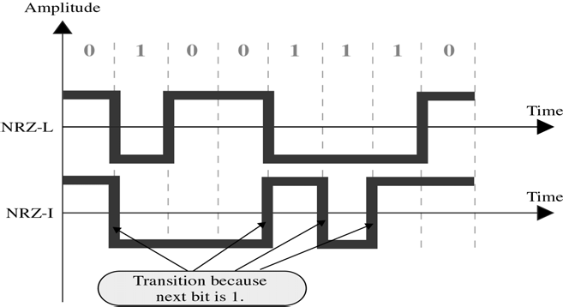
CS601-Data Communication
VU
A bit 0 is represented by no change
NRZ-I is superior to NRZ-L due to synchronization provided by signal change each time a 1 bit is encountered
The string of 0’s can still cause problem but since 0’s are not as likely, they are less of a problem
Summary
Introduction to the Encoding Techniques
Digital-To-Digital Encoding
Types of Digital-To-Digital Encoding
UniPolar Encoding
Polar Encoding
– NRZ
Reading Sections
Section 5.1, “Data Communications and Networking” 4th Edition by Behrouz A. Forouzan

Slide 20
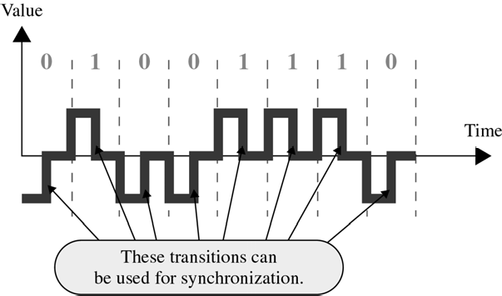
CS601-Data Communication
VU
LECTURE #15
Conversions
Return to Zero (RZ)
Any time, data contains long strings of 1’s or 0’s, Rx can loose its timing
In unipolar, we have seen a good solution is to send a separate timing signal but this solution is both expensive and full of error
A better solution is to somehow include synch in encoded signal somewhat similar to what we did in NRZ-I but it should work for both strings of 0 & 1
One solution is RZ encoding which uses 3 values : Positive, Negative and Zero
Signal changes not b/w bits but during each bit
Like NRZ-L , +ve voltage means 1 and a –ve voltage means 0, but unlike NRZ- L, half way through each bit interval, the signal returns to zero
A 1 bit is represented by positive to zero and a 0 is represented by negative to zero transition
The only problem with RZ encoding is that it requires two signal changes to encode one bit and therefore occupies more BANDWIDTH
But of the 3 alternatives we have discussed, it is most effective
Biphase Encoding
Best existing solution to the problem of Synchronization
Signal changes at the middle of bit interval but does not stop at zero
Instead it continues to the opposite pole
 |  |  | Biphase Encoding
Manchester |  |  |  |  | Differential Manchester

Slide 21
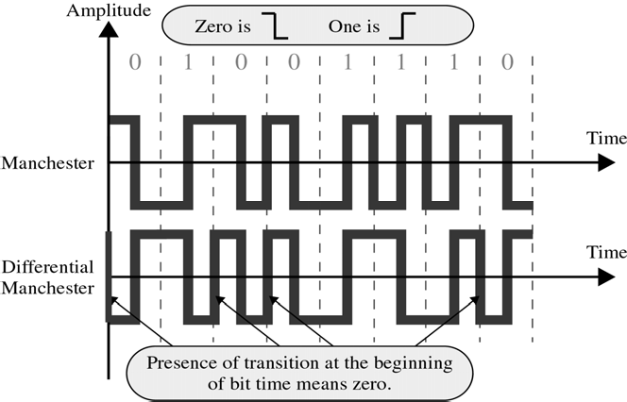
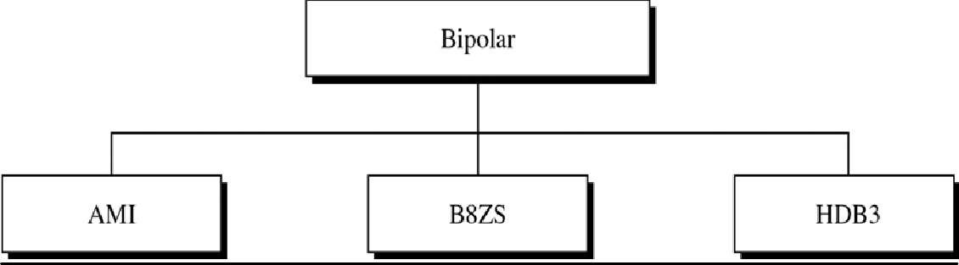
CS601-Data Communication
VU
Manchester
o Uses inversion at the middle of each bit interval for both synchronization and bit representation
*Negative-to-Positive Transition= 1
*Positive-to-Negative Transition = 0
*By using a single transition for a dual purpose, Manchester acheives the same level of synchronization as RZ but with only two levels of amplitude
Differential Manchester
Inversion at the middle of the bit interval is used for Synchronization but presence or absence of an additional transition at the beginning of bit interval is used to identify a bit
A transition means binary 0 & no transition means binary 1
Requires 2 signal changes to represent binary 0 but only one to represent binary 1
Bipolar Encoding
Like RZ, it uses three voltage levels:
Unlike RZ, zero level is used to represent binary 0
Binary 1’s are represented by alternate positive and negative voltages
Types of Bipolar Encoding

Slide 22
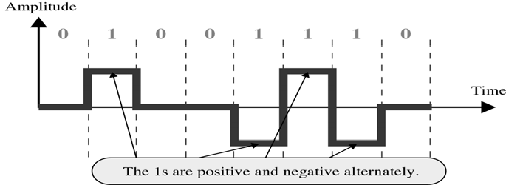
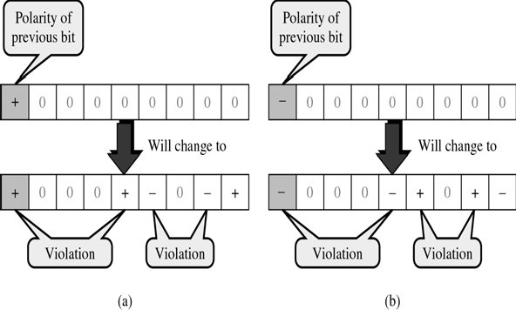
CS601-Data Communication
VU
Alternate Mark Inversion (AMI)
Simplest type of Bipolar Encoding
Mark € Comes from Telegraphy (1)
Alternate Mark Inversion means Alternate ‘1’ Inversion
Pseudoternary
By inverting on each occurrence of 1, AMI accomplishes 2 things:
–The DC component is zero
–Long sequence of 1’s stay synchronized
No mechanism of ensuring synch is there for long stream of 0’s
Two variations are developed to solve the problem of synchronization of sequential 0’s
–B8ZS € used in North America
–HDB3 € used in Europe & Japan
Both modify original pattern of AMI only on case of long stream of zeroes
B8ZS
Convention adopted in North America to provide synch for long string of zeros
Difference b/w AMI and B8ZS occurs only when 8 or more consecutive zeros are encountered
Forces artificial signal changes called VIOLATIONS
Each time eight 0’s occur , B8ZS introduces changes in pattern based on polarity of previous 1 (the ‘1’ occurring just before zeros)

Slide 23
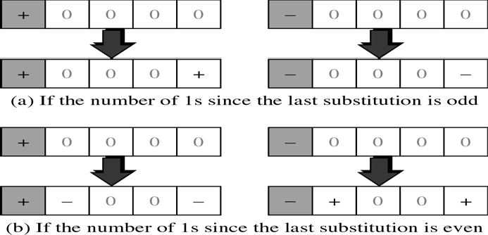
CS601-Data Communication
VU
HDB3
Alteration of AMI adopted in Europe and Japan
Introduces changes into AMI, every time four consecutive zeros are encountered instead of waiting for eight zeros as in the case of B8ZS
As in B8ZS, the pattern of violations is based on the polarity of the previous 1 bit Unlike B8ZS, HDB3 also looks at the no. of 1’s that have occurred since the last substitution
Summary
Types of Digital-To-Digital Encoding
Polar Encoding
Return to Zero (RZ) Encoding
Biphase Encoding
Bipolar Encoding
Reading Sections
Section 5.1, “Data Communications and Networking” 4th Edition by Behrouz A. Forouzan

